Slide 1

Genetic variation in the Endothelin ETA Receptor contributes to microvascular angina
PRIZE Endothelin Sub-study
Dr GR Abraham, Royal Papworth Hospital NHS Foundation Trust &
Experimental Medicine and Immunotherapeutics, University of Cambridge
1 September 2025

Slide 2
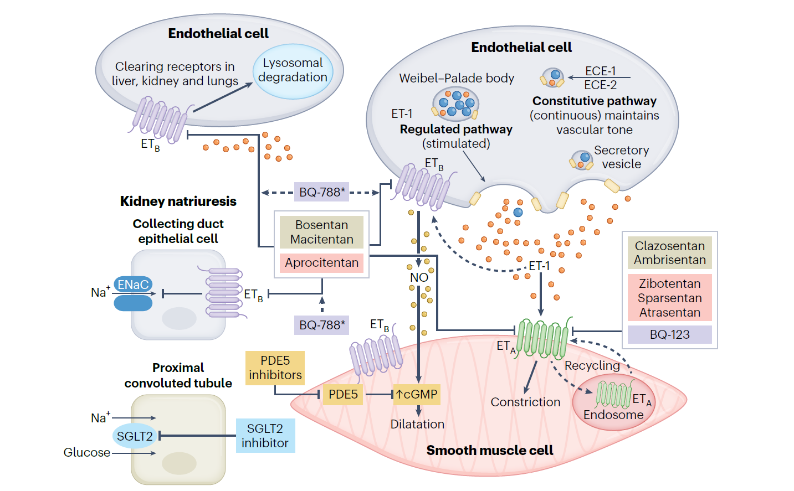
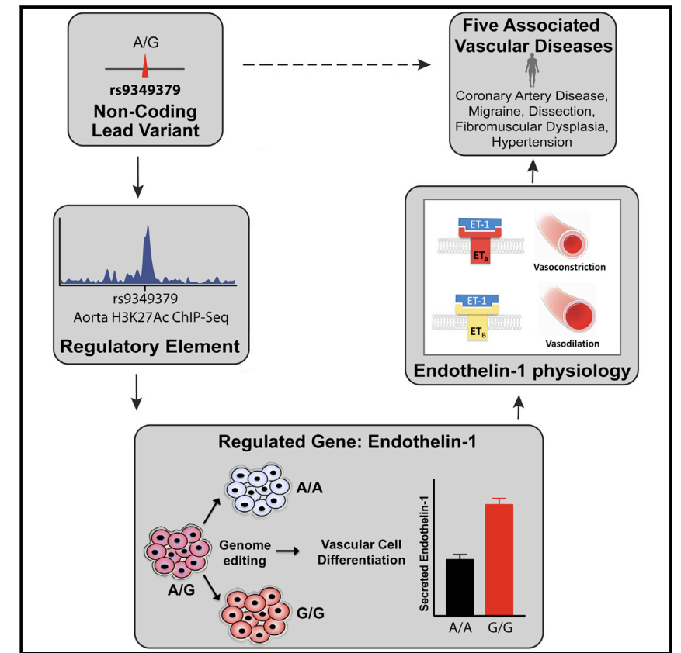
ET-1 is a potent endothelial derived vasoconstrictor peptide and genetic variants influence ET-1 physiology
Abraham, George R., et al. "Current and future strategies for targeting the endothelin pathway in cardiovascular disease." Nature Cardiovascular Research 2.11 (2023): 972-990.
Gupta, Rajat M., et al. "A genetic variant associated with five vascular diseases is a distal regulator of endothelin-1 gene expression." Cell 170.3 (2017): 522-533.

Slide 3
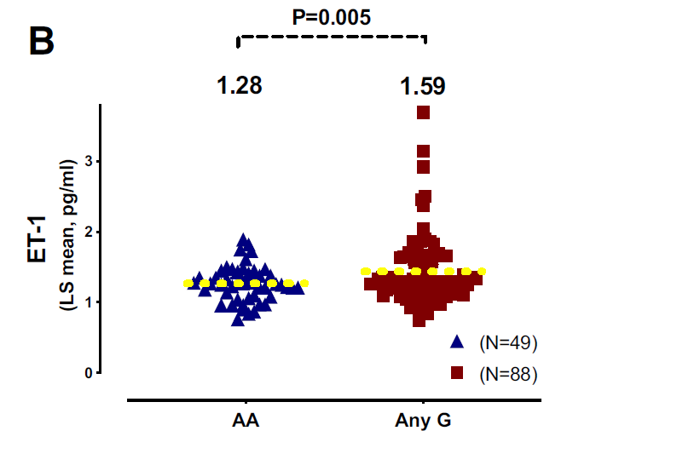
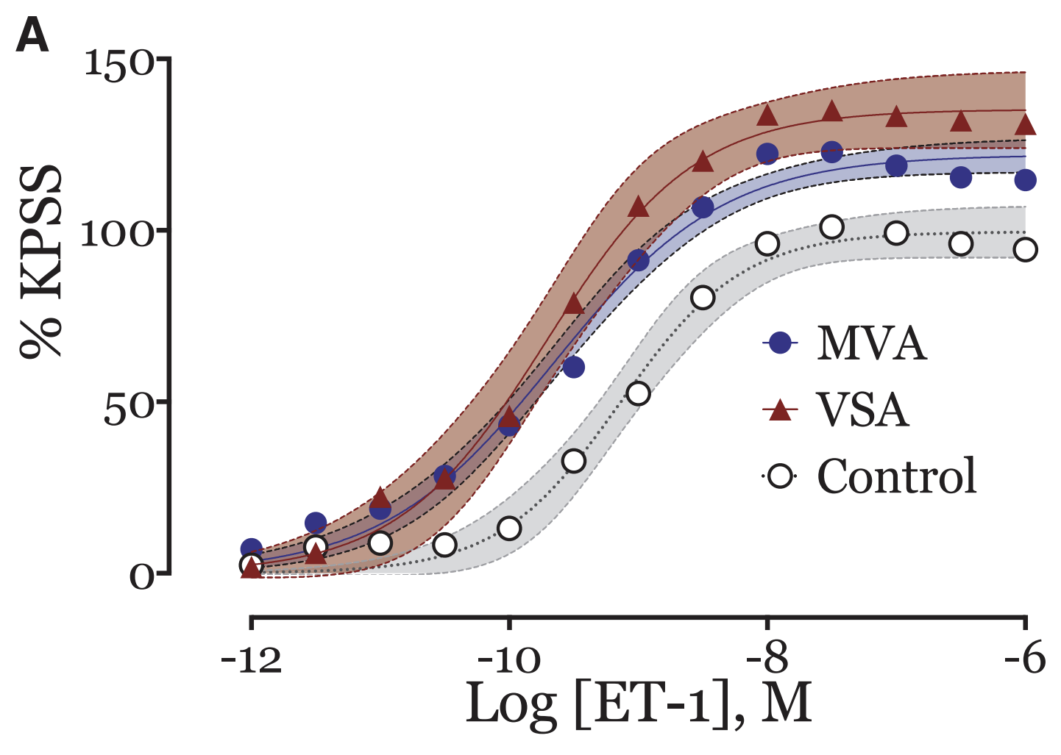
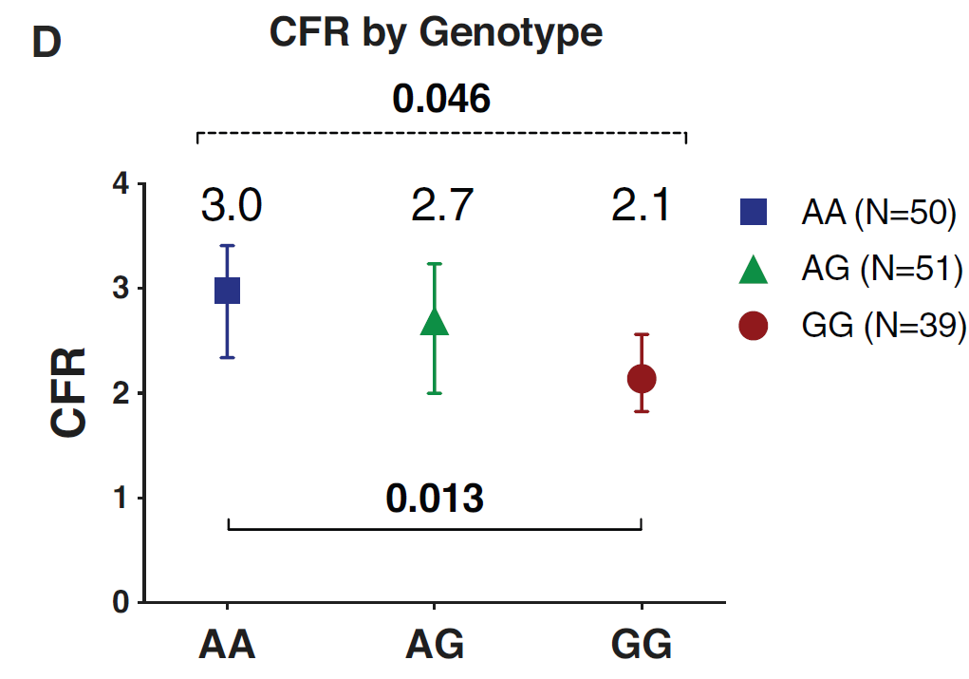
Increased sensitivity to ET-1 is a feature of microvascular angina
The SNP: rs9349379-G allele is associated with high ET-1 and risk of CMD
Ford, Thomas J., et al. "Genetic dysregulation of endothelin-1 is implicated in coronary microvascular dysfunction." European Heart Journal 41.34 (2020): 3239-3
Ford, Thomas J., et al. "Systemic microvascular dysfunction in microvascular and vasospastic angina." European heart journal 39.46 (2018): 4086-4097.252.

Slide 4
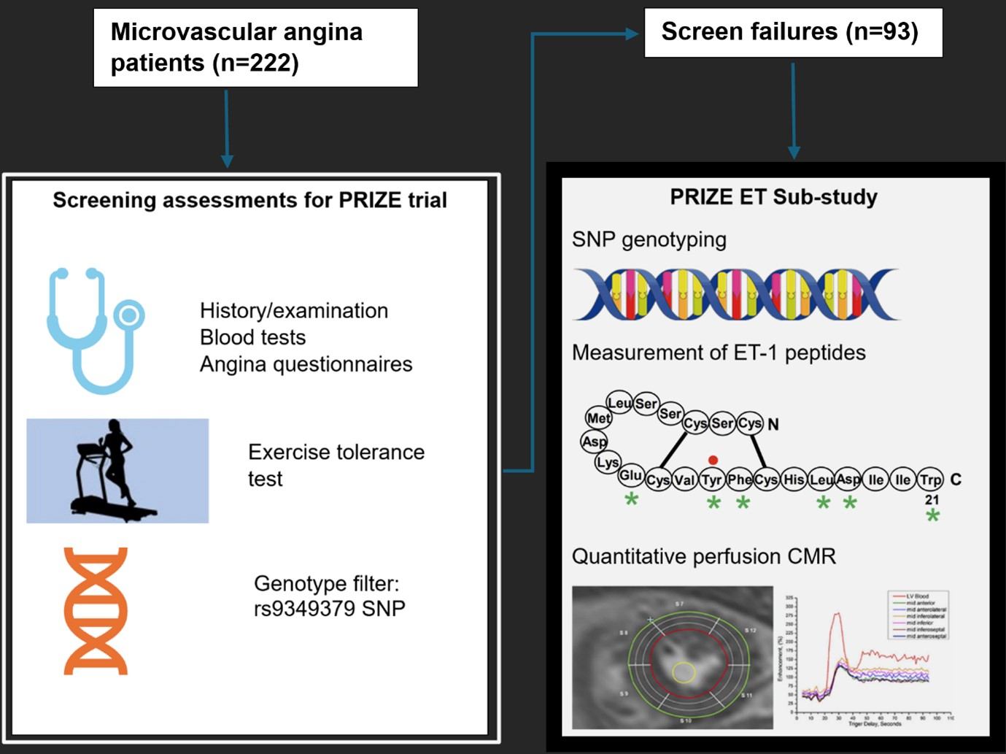
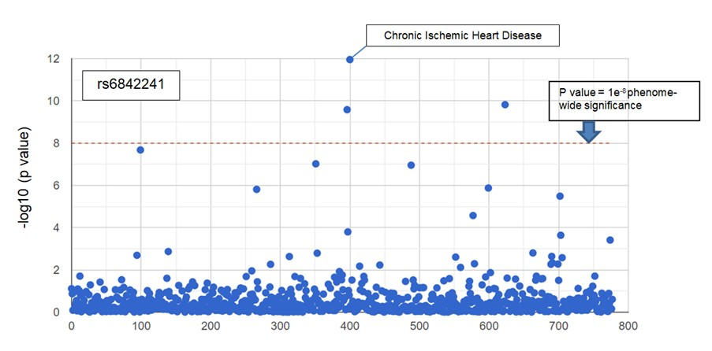
These results led to the PRIZE trial and PRIZE Endothelin Sub-study
Microvascular angina patients ineligible for the PRIZE study after screening assessments were enrolled in the observational sub-study
Investigations included SNP genotyping of other ET-1 related variants such as rs6842241 associated with EDNRA
Generated from tool accessed from http://geneatlas.roslin.ed.ac.uk/phewas/

Slide 5
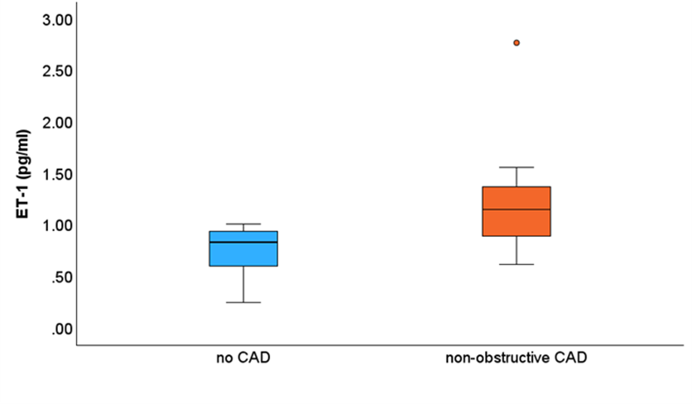

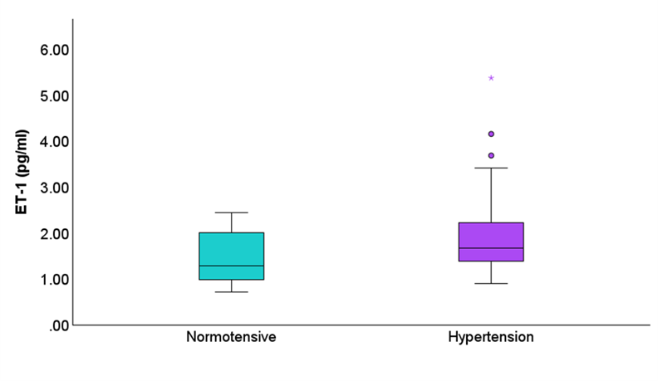
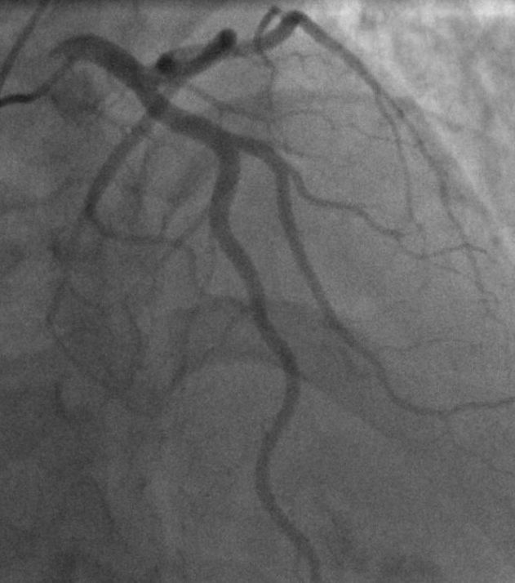
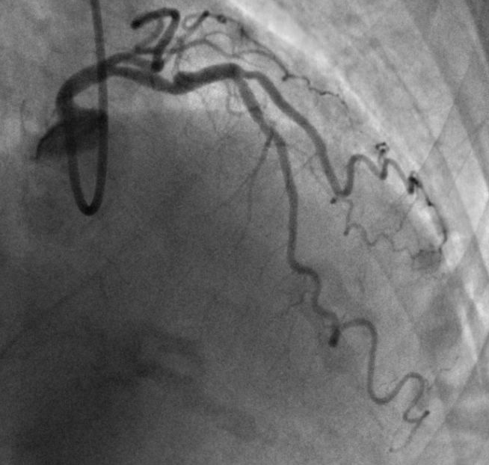
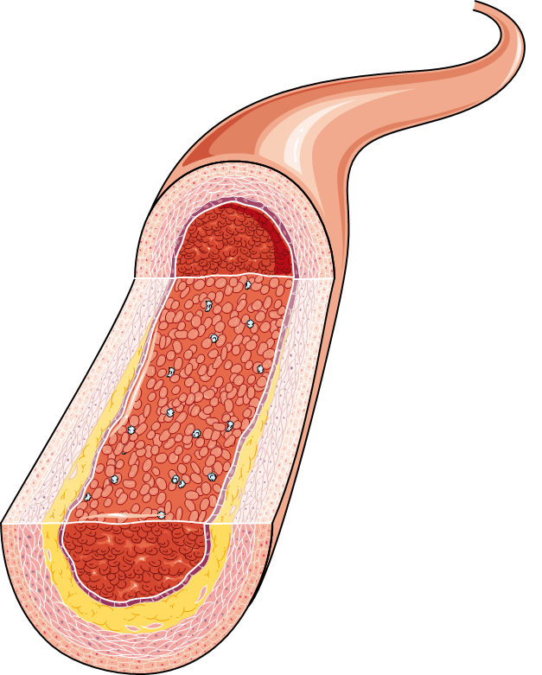
Results: 93 microvascular angina patients were enrolled in the observational study from 10 sites in the UK; 88 had genotyping; 22 had stress perfusion CMR
P = 0.02
P = 0.01
Elevated plasma ET-1 was associated with coronary atherosclerosis and hypertension
Cartoon images provided by Servier Medical Art licensed under CC BY 4.0

Slide 6
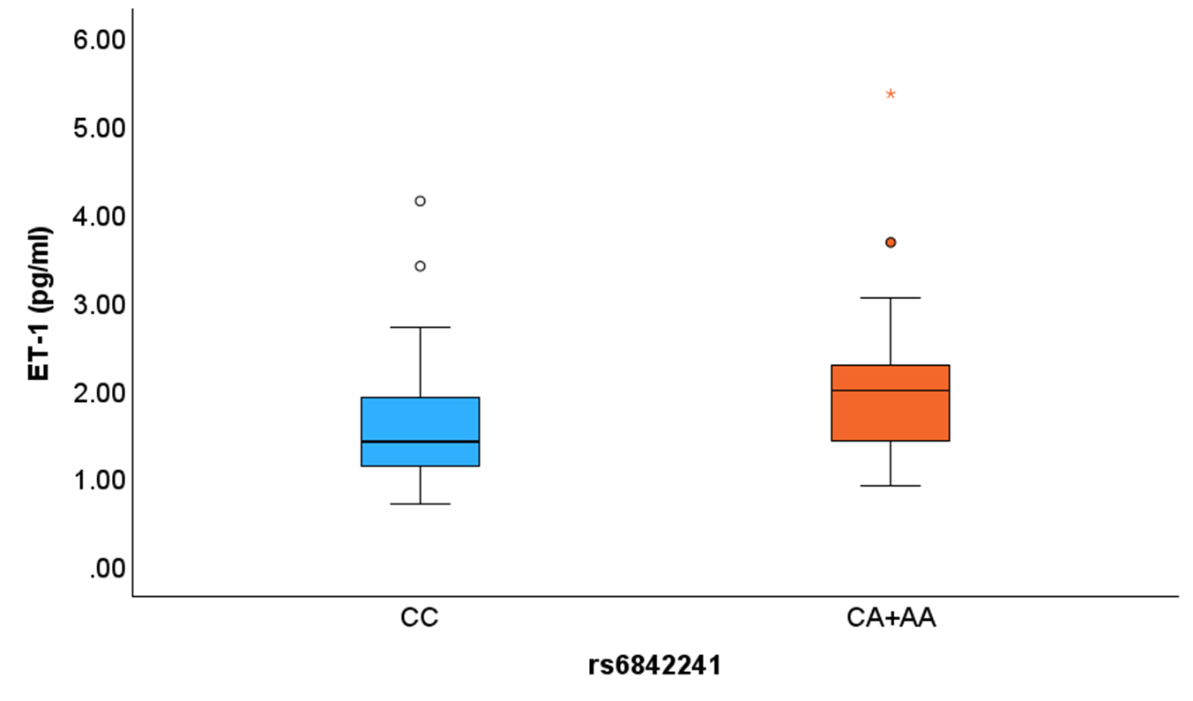
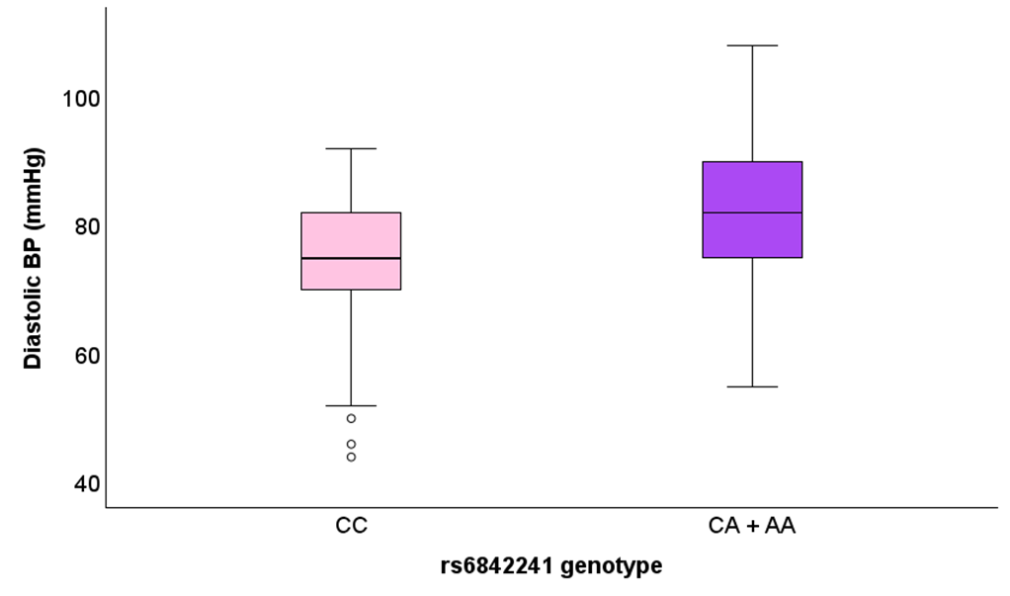
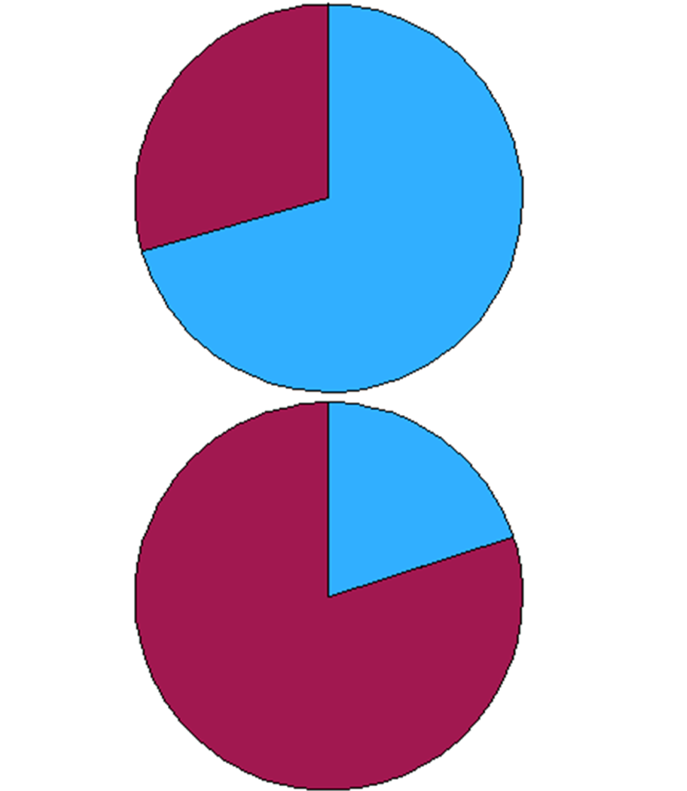
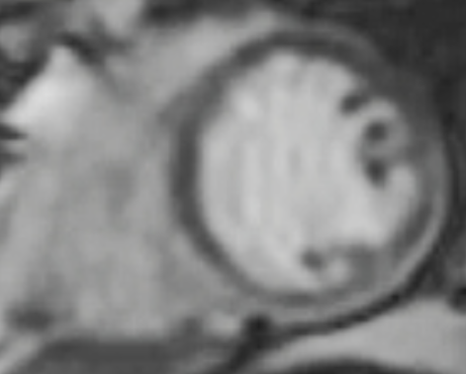

EDNRA SNP rs6842241-A allele associated with:
Significantly higher circulating ET-1
Increased likelihood of subendocardial perfusion defects
Increased diastolic blood pressure
P = 0.01
P <0.01
CC
CA + AA
4/5 patients with the risk allele had subendocardial hypoperfusion compared to 5/17 without (X²=4.09, p=0.04)
Guglielmo, Marco, Andrea Baggiano, and Gianluca Pontone. "Clinical Efficiency of Absolute Quantitative Cardiovascular Magnetic Resonance Myocardial Perfusion for Coronary Artery Disease." CARDIOLOGY (2021).

Slide 7
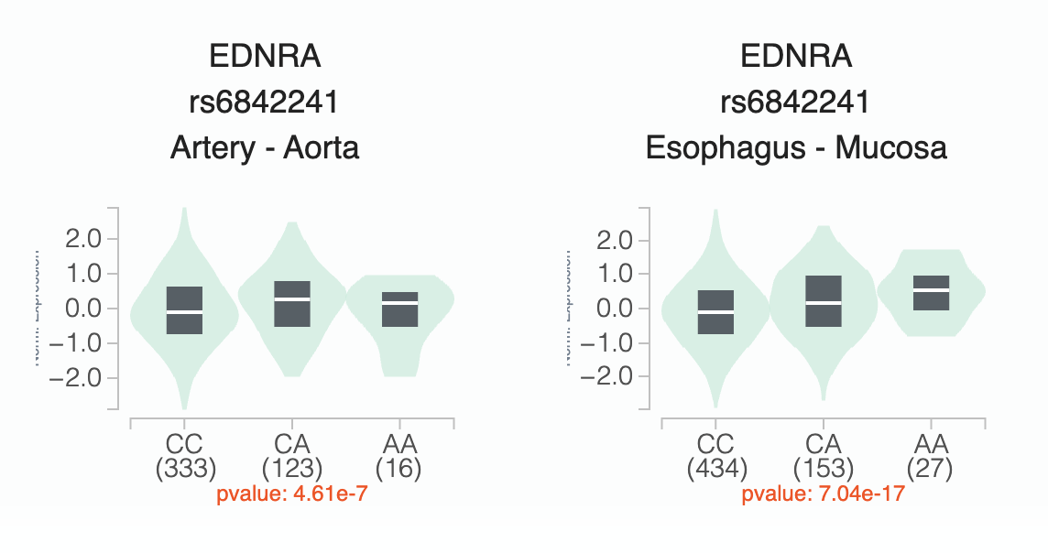
Summary and conclusions
The PRIZE ET sub-study was an observational cross-sectional study investigating genetic variants relevant to microvascular angina and the ET-1 vasoconstrictor pathway
The minor A allele of the ET_{A} receptor gene SNP: rs6842241, a known coronary artery disease genetic risk variant, is associated with elevated circulating ET-1
The risk variant was also associated with increased diastolic blood pressure and subendocardial hypoperfusion on cardiac MRI
The relationship of elevated ET-1 with a genetic variant of the receptor requires further investigation
Data from the GTEx project suggests this variant causes up-regulated ET_{A} receptor expression
The variant is therefore a potential new target for precision medicine in microvascular angina using ET_{A} receptor antagonist therapy
Data Source: GTEx Analysis Release V10 (dbGaP Accession phs000424.v10.p2)

Slide 8
Acknowledgements
PRIZE ET Sub-study research team
Majid Anwar
Andrew Morrow
Joana Oliveira
Jonathan Weir-McCall
Colin Berry
Anthony Davenport
Stephen Hoole
This research was funded by the Jon Moulton Charity Trust
We are very grateful to all the patients who have supported this study
And for the enormous contribution of colleagues from Royal Papworth Hospital, the Department of Experimental Medicine and Immunotherapeutics, Department of Pathology at University of Cambridge, and Research and Innovation, NHS Greater Glasgow and Clyde
RPH Project Management
Melissa Duckworth
Jo Steele
Comfort Ajani

